Slide 1
AtliQ Mart Promotion Analysis
Sunitha Madhavadhas

Slide 2
Introduction
AtliQ Mart is a retail giant with over 50 supermarkets in the southern region of India.
All their 50 stores ran a massive promotion during the Diwali 2023 and Sankranti 2024(festive time in India) on their AtliQ branded products.
Now the sales director wants to understand which promotions did well and which did not so that they can make informed decisions for their next promotional period.

Slide 3
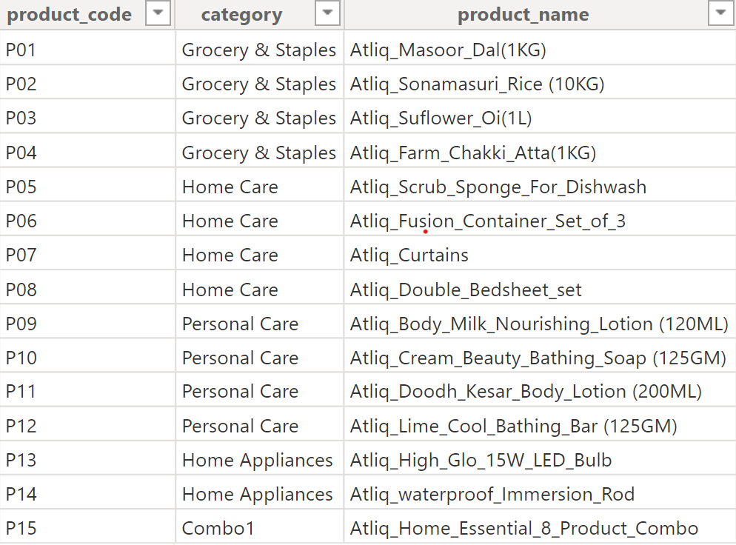
Data
AtliQ Mart sells
- 15 Products
- 5 categories

Slide 4
Totally 50 stores across India
city | store_count
Bengaluru | 10
Chennai | 8
Hyderabad | 7
Coimbatore | 5
Visakhapatnam | 5
Madurai | 4
Mysuru | 4
Mangalore | 3
Trivandrum | 2
Vijayawada | 2

Slide 5
Types Of Campaign
- Diwali(12th November 2023 – 18th November 2023)
- Sankranti (10th January 2024 – 16th January 2024)

Slide 6
Types of Promotion
- 25% off
- 33% off
- 50% off
- 500 cashback
- BOGOF (Buy One Get One Free)

Slide 7
IR and ISU
IR – Incremental Revenue
Incremental revenue is the additional revenue that a company generates from selling new products or services or from expanding into new markets.
ISU - Incremental Sold Unit
Incremental sales are the additional units of a product that companies sell to retailers or consumers because of a sales promotion. When a sale is incremental, it's made by a customer who responded to a specific action, campaign or partner.

Slide 8
Store Performance Analysis

Slide 9
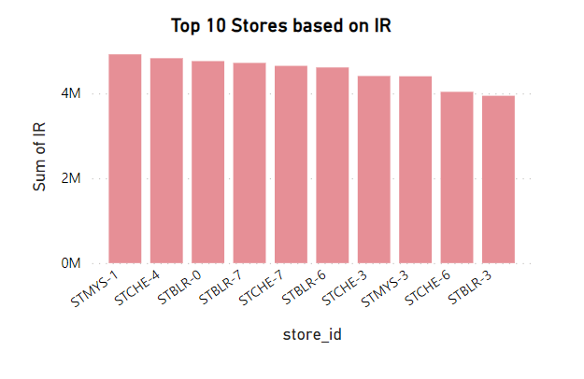
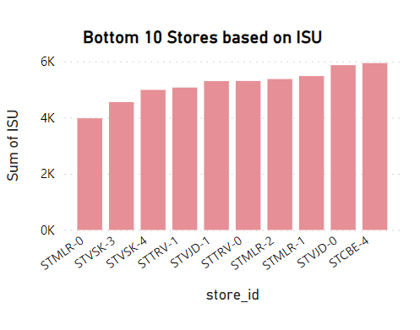
Store Performance Analysis
Top 10 stores and Bottom 10 stores

Slide 10
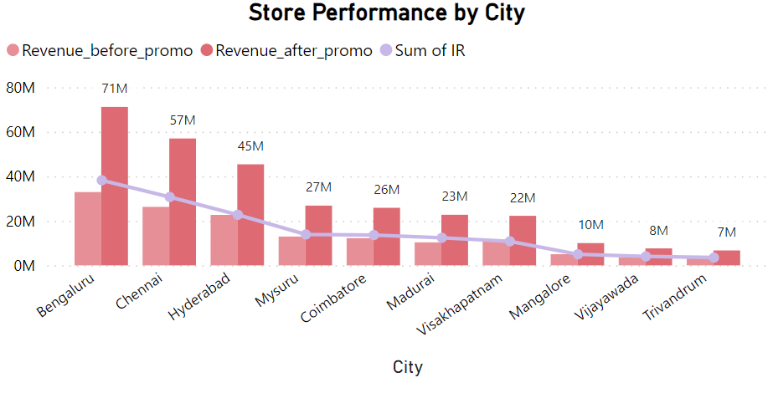
Stores in Bengaluru has the highest growth based on Revenue & IR

Slide 11
Promotion Type Analysis

Slide 12
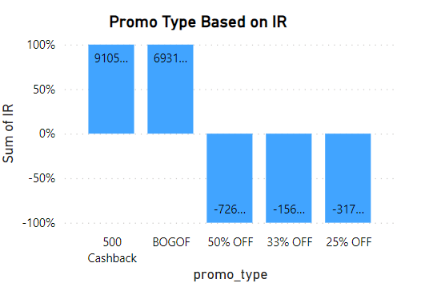
Top 2 Promotion Types based on highest Incremental Revenue
- 500 Cashback (91.05 Million)
- BOGOF (69.32 Million)

Slide 13
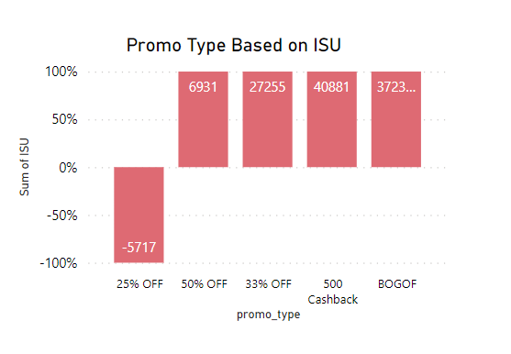
Bottom 2 Promotion Types based on Incremental Sold Unit
- 25% OFF
- 50% OFF

Slide 14
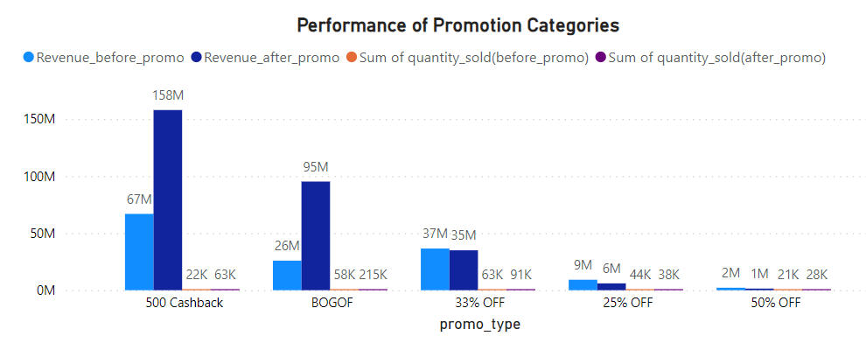
Performance of discount-based promotions Vs BOGOF Vs 500 Cashback

Slide 15
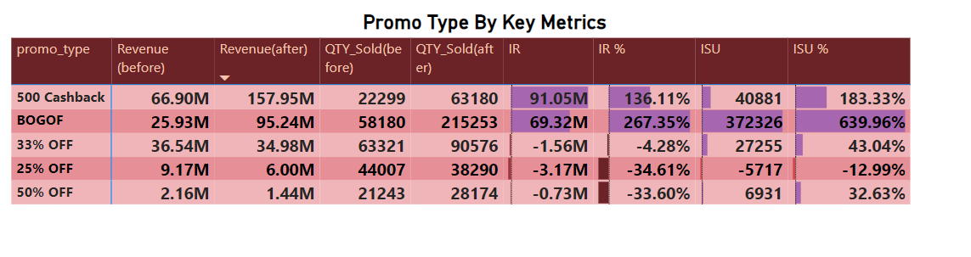
Promotion that maintain healthy margin
BOGOF(Buy One Get One Free) promotion type strike the best balance between Incremental Sold Units and maintaining healthy margins.

Slide 16
Product and Category Analysis

Slide 17
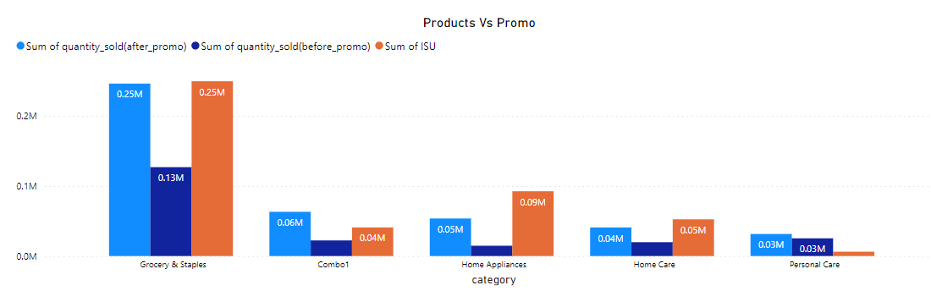
Product Categories found lift in sales
Grocery & Staples Categories found most lift in sales

Slide 18
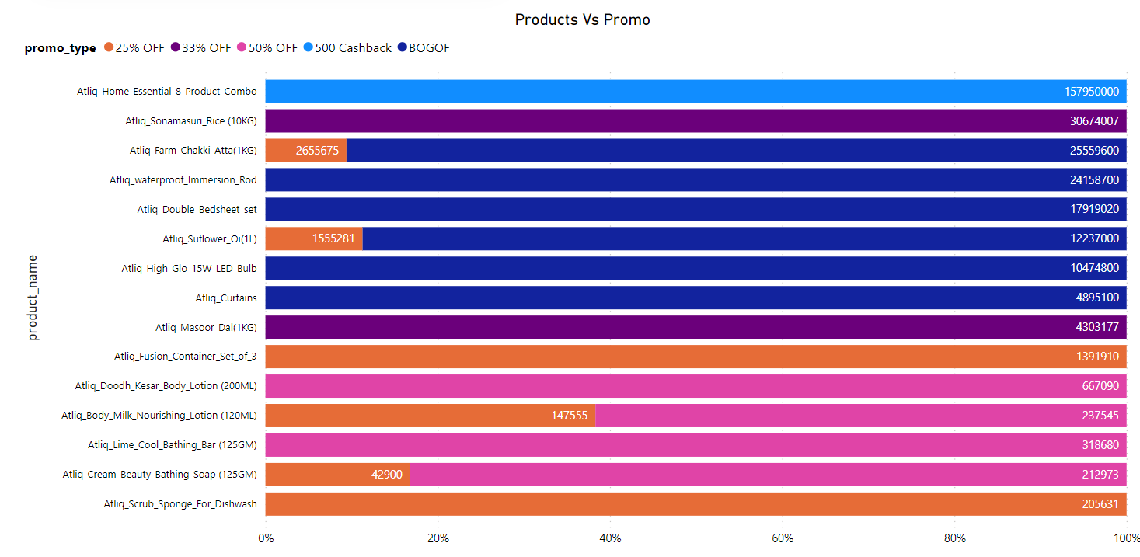
Product Vs Promo

Slide 19
Business Requests

Slide 20
1. List of products with base price >500 featured in promo type BOGOF
Query1 :
select distinct p.product_name,base_price from fact_events f
inner join dim_products p using (product_code)
where base_price > 500 and promo_type ="BOGOF";
Result:
product_name | base_price
Atliq_Double_Bedsheet_set | 1190
Atliq_waterproof_Immersion_Rod | 1020

Slide 21
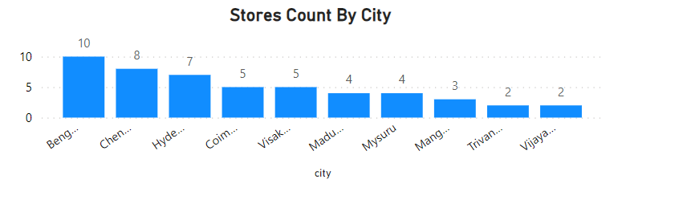
2.Number of stores in each city
Query2:
select city,count(store_id) as store_count from dim_stores
group by city order by store_count desc;
Result:
city | store_count
Bengaluru | 10
Chennai | 8
Hyderabad | 7
Coimbatore | 5
Visakhapatnam | 5
Madurai | 4
Mysuru | 4
Mangalore | 3
Trivandrum | 2
Vijayawada | 2

Slide 22
3. Campaign name along with Total revenue before and after the campaign
Query3:
with cte1 as
( select campaign_id,promo_type,base_price,
CASE
WHEN promo_type = "50% off" THEN base_price * (1 - 0.50)
WHEN promo_type = "25% off" THEN base_price * (1 - 0.25)
WHEN promo_type = "bogof" THEN base_price * (1 - 0.50)
WHEN promo_type = "500 cashback" THEN (base_price - 500)
WHEN promo_type = "33% off" THEN base_price * (1 - 0.33)
ELSE base_price
END AS new_promo_price,
CASE
WHEN promo_type = "bogof" THEN `quantity_sold(after_promo)`* 2
ELSE `quantity_sold(after_promo)`
END AS qty_after_promo,
`quantity_sold(before_promo)` as qty_before_promo
from fact_events)
select c.campaign_name, round(sum(base_price*qty_before_promo)/1000000,2) as revenue_before_promo_mln,
round(sum(new_promo_price * qty_after_promo)/1000000,2) as revenue_after_promo_mln from cte1 ct
inner join dim_campaigns c using (campaign_id)
group by ct.campaign_id;
Result:
campaign_name | revenue_before_promo_mln | revenue_after_promo_mln
Sankranti | 58.13 | 124.15
Diwali | 82.57 | 171.46

Slide 23
4.Incremental Sold Quantity(ISU) for each category during the diwali
Query4:
with cte1 as
( select p.category,c.campaign_name, sum(`quantity_sold(before_promo)`) as qty_before_promo,
sum(CASE
WHEN promo_type = "bogof" THEN `quantity_sold(after_promo)`* 2
ELSE `quantity_sold(after_promo)`
END) AS qty_after_promo
from fact_events f
inner join dim_products p using (product_code)
inner join dim_campaigns c using (campaign_id)
where campaign_name ="Diwali" group by category),
cte2 as
(select category, qty_before_promo, qty_after_promo , qty_after_promo - qty_before_promo as ISU,
(qty_after_promo - qty_before_promo)/qty_before_promo*100 as ISU_Percent from cte1)
select *,dense_rank() over (order by ISU_percent desc) as Rank_order from cte2;
Result:
category | qty_before_promo | qty_after_promo | ISU | ISU_Percent | Rank_order
Home Appliances | 5230 | 36006 | 30776 | 588.4512 | 1
Home Care | 13326 | 40396 | 27070 | 203.1367 | 2
Combo1 | 16791 | 50769 | 33978 | 202.3584 | 3
Personal Care | 16843 | 22074 | 5231 | 31.0574 | 4
Grocery & Staples | 58129 | 68620 | 10491 | 18.0478 | 5

Slide 24
5.Top 5 products ranked by IR% across all campaigns
Query 5:
with cte1 as
( select f.product_code,p.category,p.product_name,base_price,
CASE
WHEN promo_type = "50% off" THEN base_price * (1 - 0.50)
WHEN promo_type = "25% off" THEN base_price * (1 - 0.25)
WHEN promo_type = "bogof" THEN base_price * (1 - 0.50)
WHEN promo_type = "500 cashback" THEN (base_price - 500)
WHEN promo_type = "33% off" THEN base_price * (1 - 0.33)
ELSE base_price
END AS new_promo_price,
CASE
WHEN promo_type = "bogof" THEN `quantity_sold(after_promo)`* 2
ELSE `quantity_sold(after_promo)`
END AS qty_after_promo,
`quantity_sold(before_promo)` as qty_before_promo
from fact_events f inner join dim_products p using (product_code)),
cte2 as
(select product_name, category,round((sum(new_promo_price * qty_after_promo)-sum(base_price *qty_before_promo))/sum(base_price *qty_before_promo)*100,2) as `IR%` from cte1 group by product_name )
select *,dense_rank() over( order by `IR%` desc) as `rank` from cte2 limit 5;
Result:
product_name | category | IR% | rank
Atliq_waterproof_Immersion_Rod | Home Appliances | 266.19 | 1
Atliq_High_Glo_15W_LED_Bulb | Home Appliances | 262.98 | 2
Atliq_Double_Bedsheet_set | Home Care | 258.27 | 3
Atliq_Curtains | Home Care | 255.34 | 4
Atliq_Farm_Chakki_Atta (1KG) | Grocery & Staples | 160.01 | 5

Slide 25
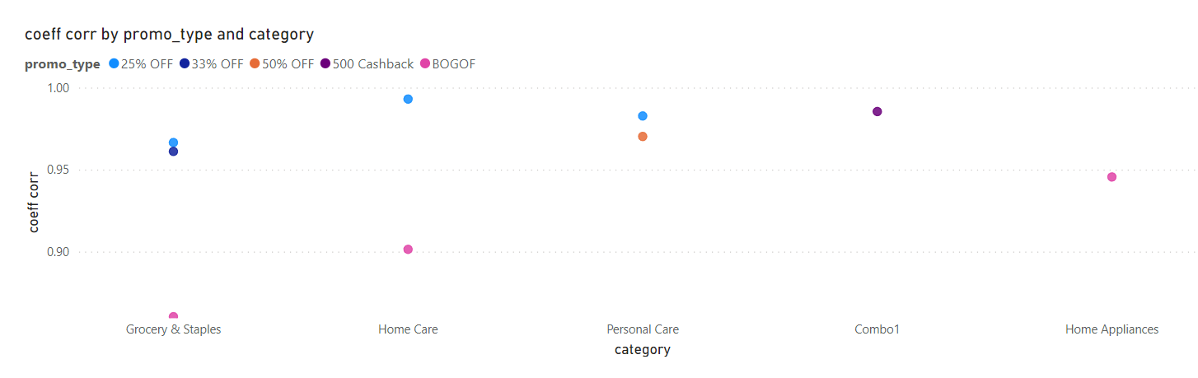
Correlation between Product Category and Promotion type

Slide 26
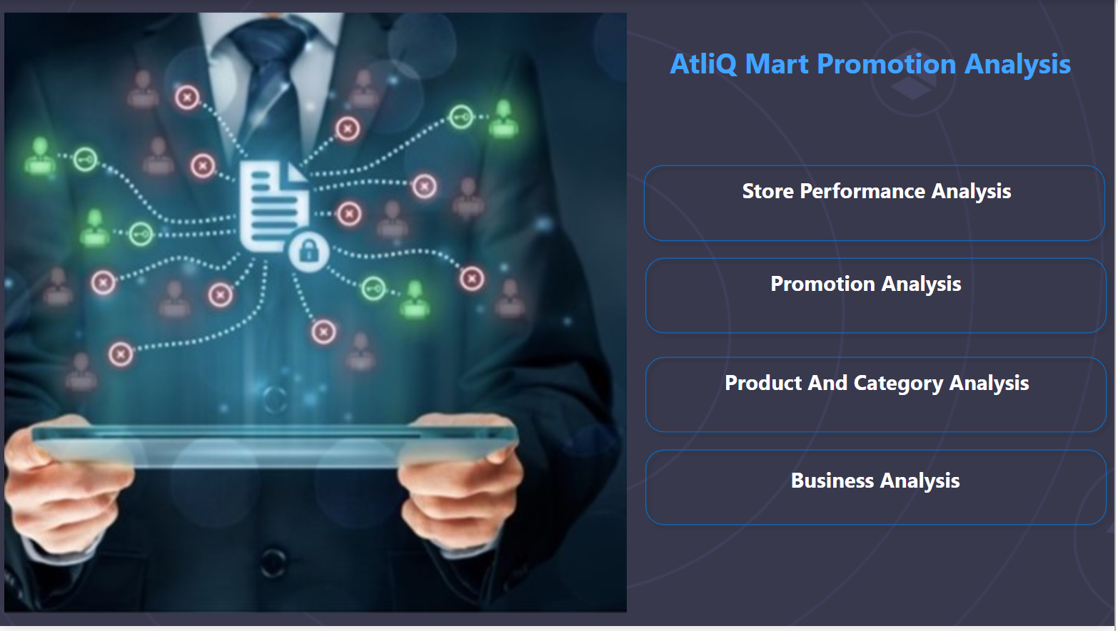
Power BI Report

Slide 27
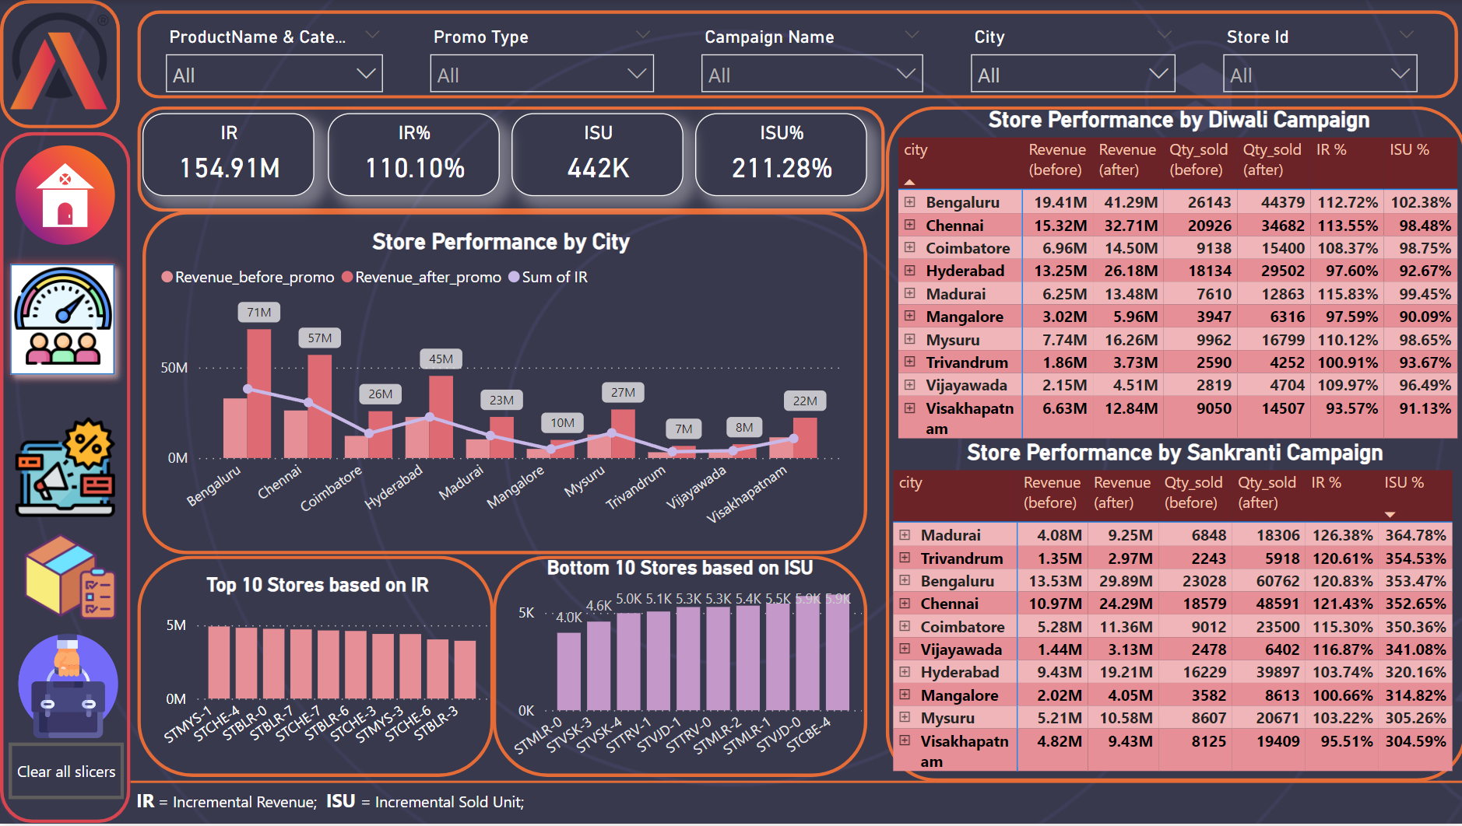
Store Performance Analysis

Slide 28
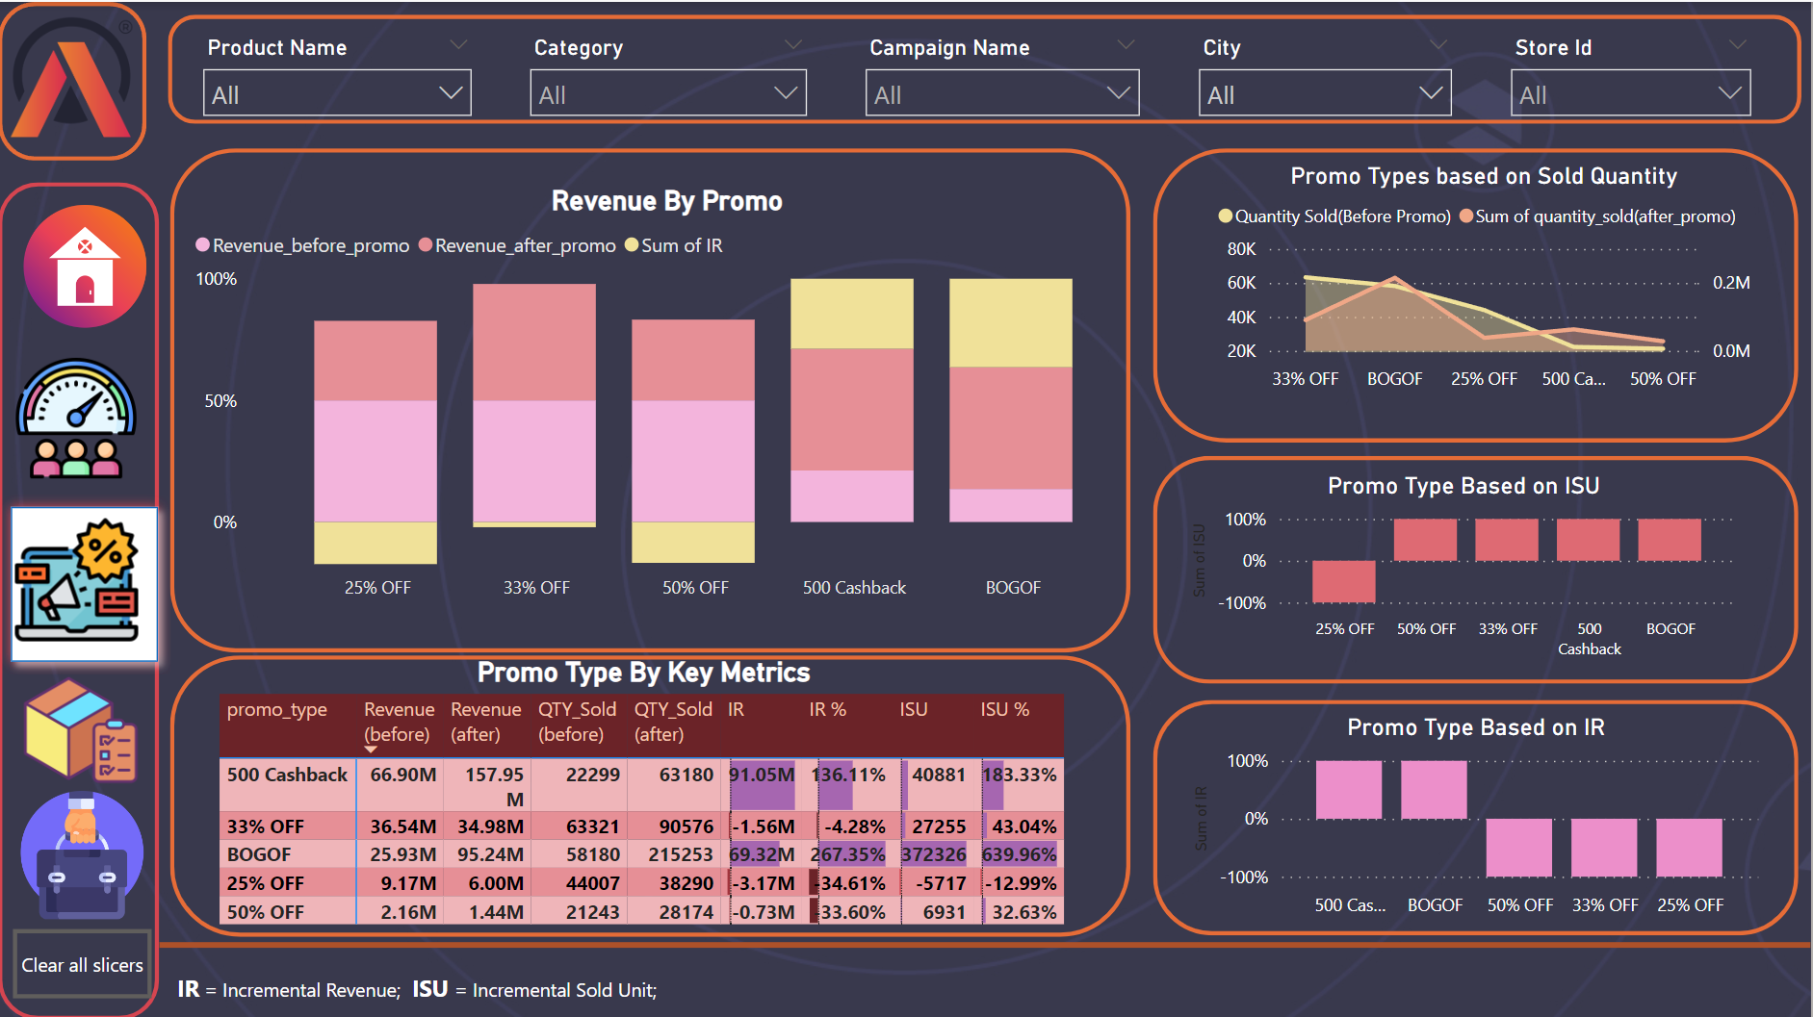
Promotion Analysis

Slide 29
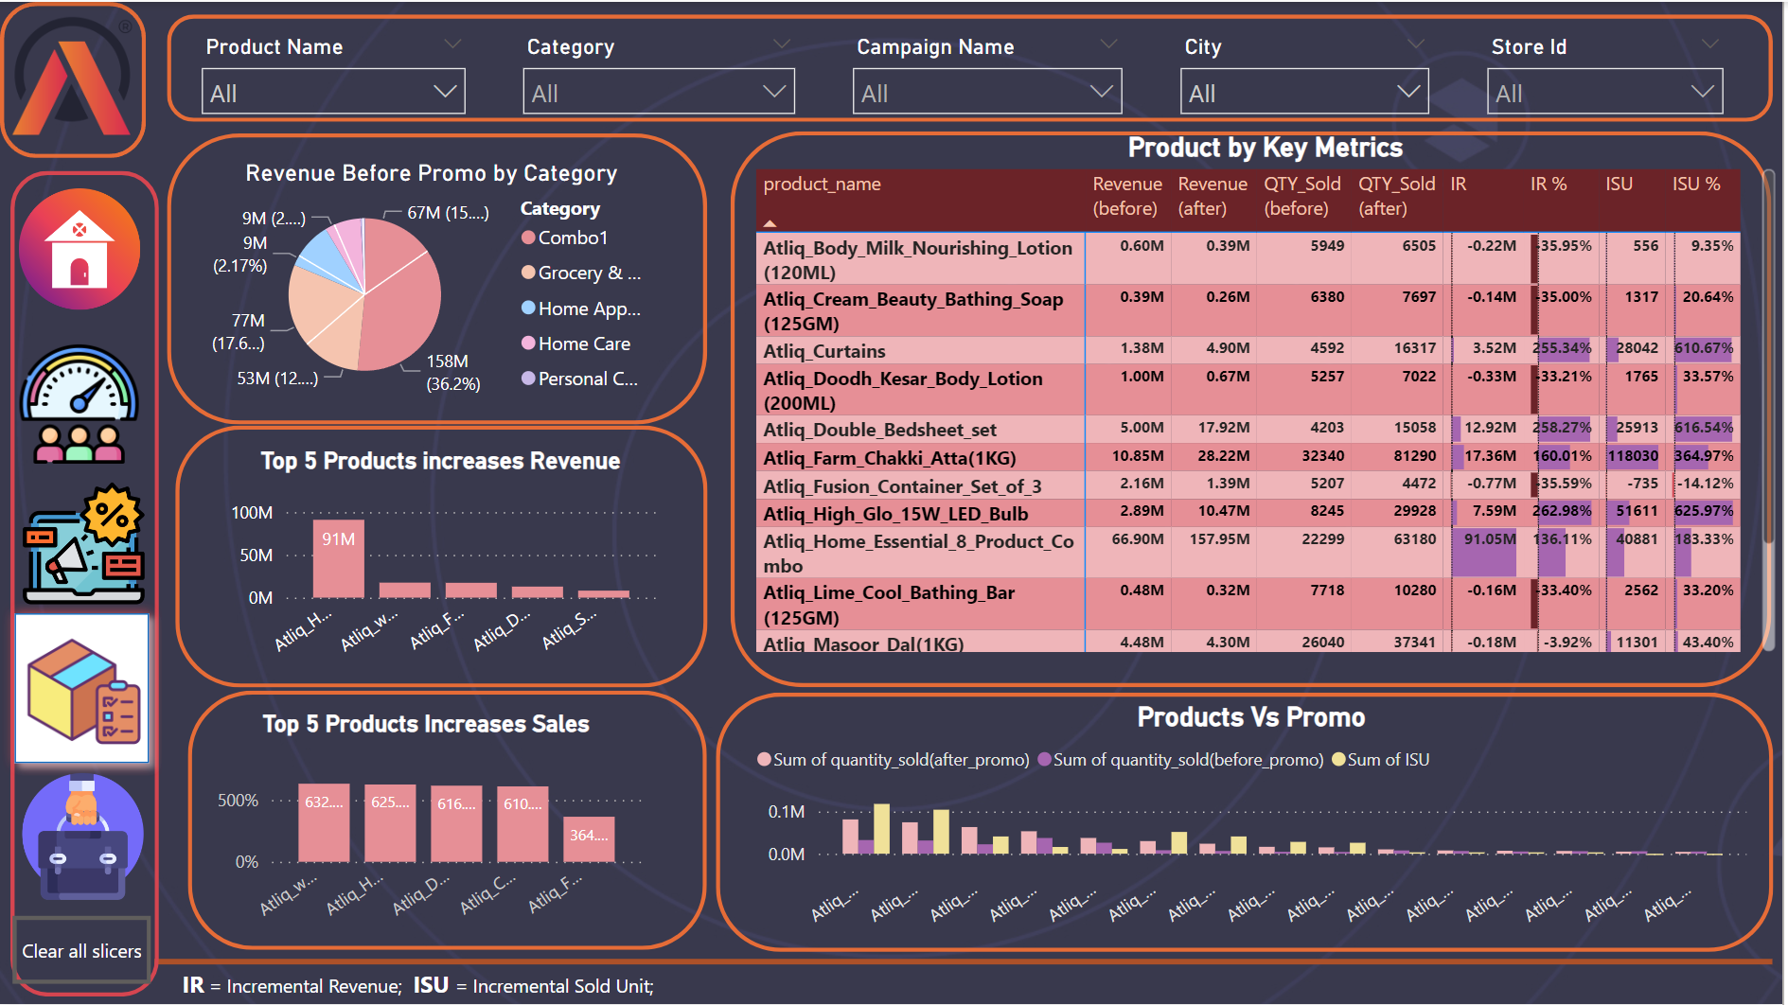
Product and Category Analysis

Slide 30
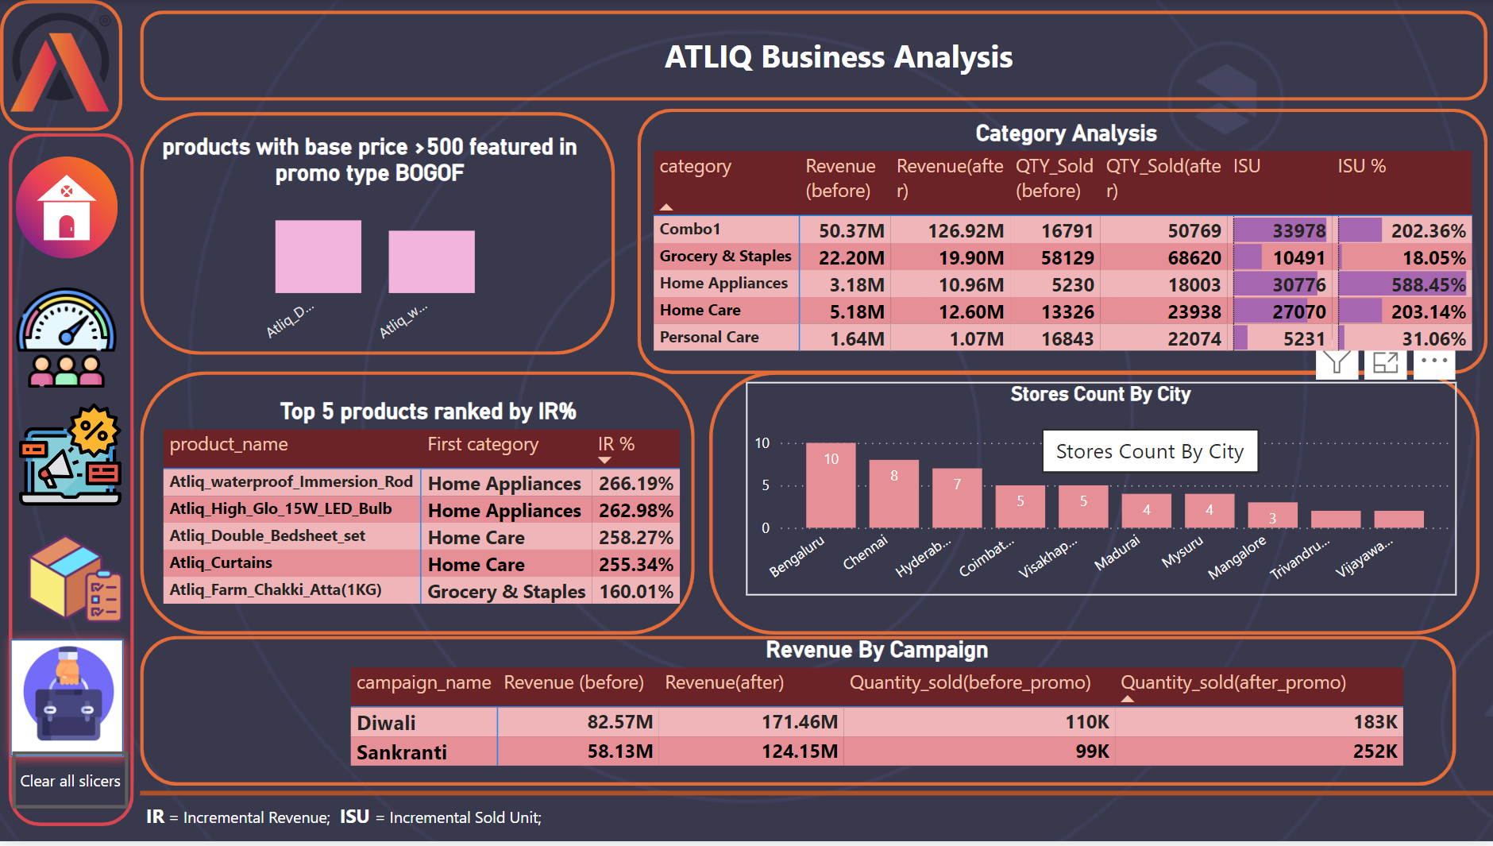
Business Analysis

Slide 31
Summary
Based on Revenue, Diwali Campaign outperforms Sankranti campaign with 171 Million Revenue.
The stores in Bengaluru generated more revenue. Visakhapatnam stores generated less revenue.
STMYS1(Store in Mysore) gave excellent Incremental Revenue
Promo types BOGOF & 500 cashback gave significant sales and revenue growth. 25% off had a detrimental impact
Combo1 category provides highest revenue of 127 Million & Home appliance category has highest Incremental sold quantity percentage.

Slide 32
Thank you
Sunitha Madhavadhas
msunith@gmail.com

